Slide 1
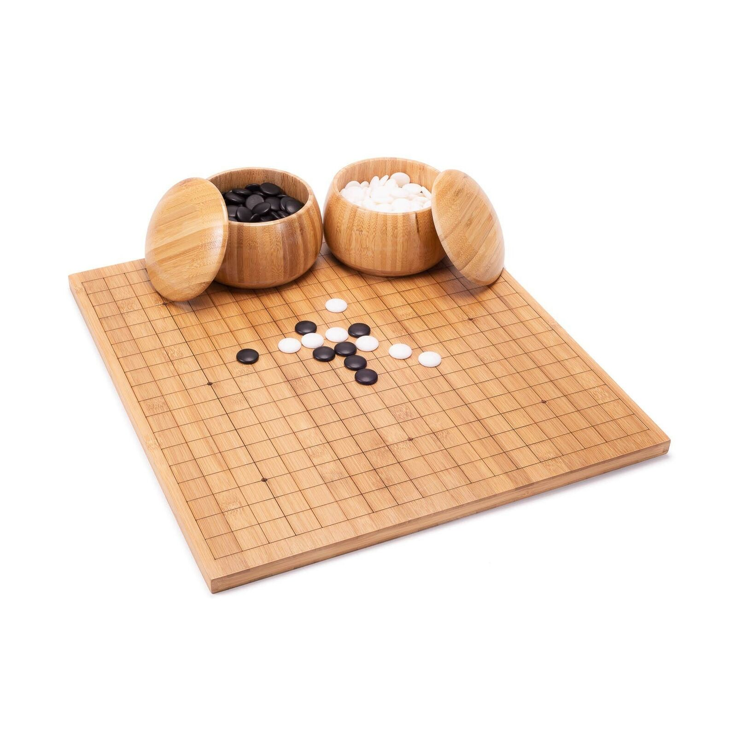
Othello
钟梓轩
曾己

Slide 2
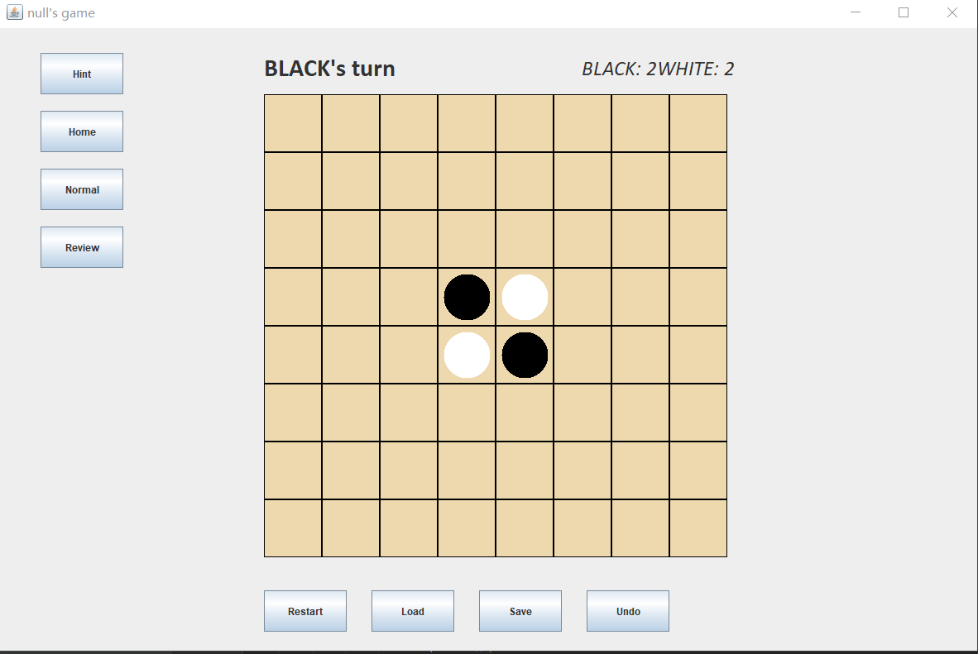
Task 1: Initialize Game (20 pts)
Initialize Game
Display Status
Restart Game

Slide 3
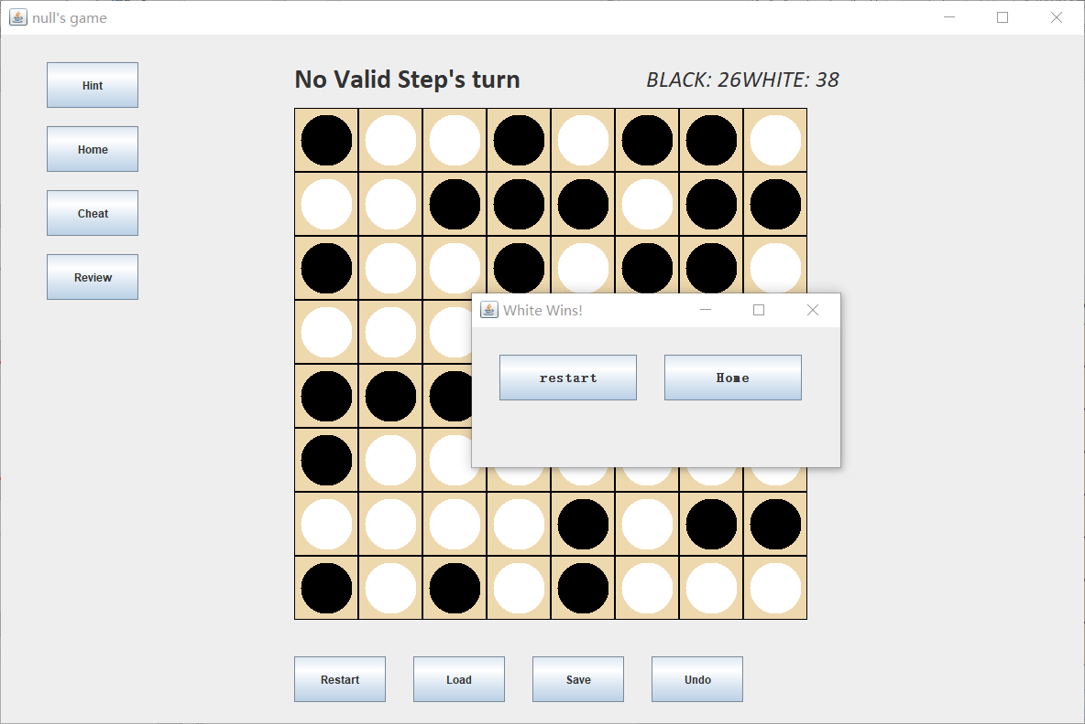
Task 2: Load and Save a Game (20 pts)
Load File
Save File
Error Check
or
Status Check

Slide 4
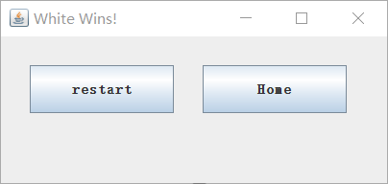
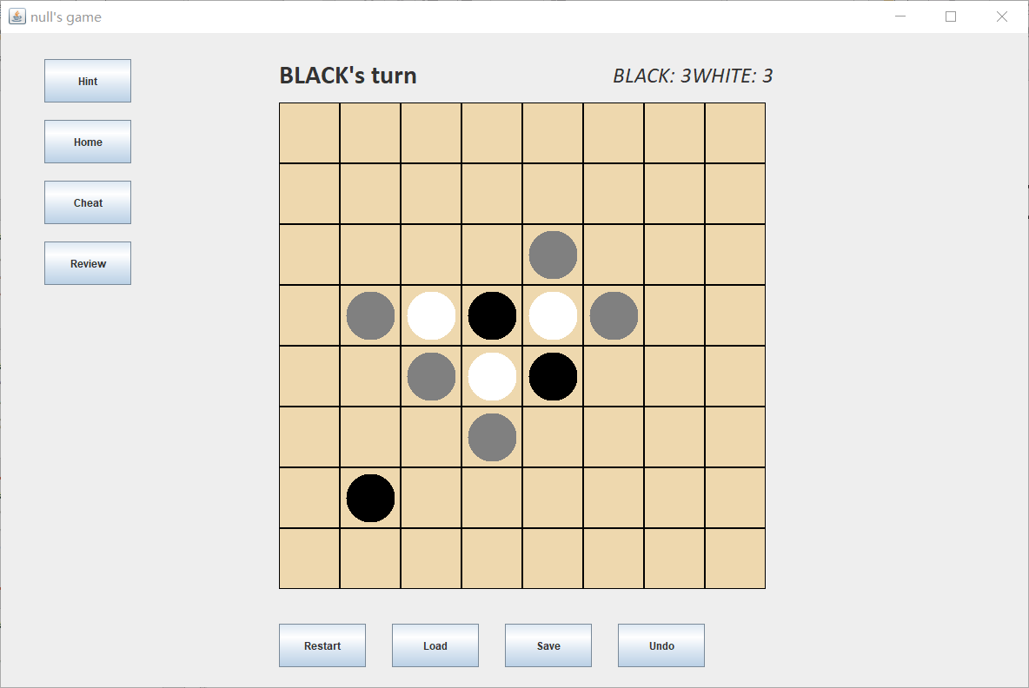
Task 3: Play the game (20 pts)
End With Winner
Flip Disks
Cheat & Normal

Slide 5
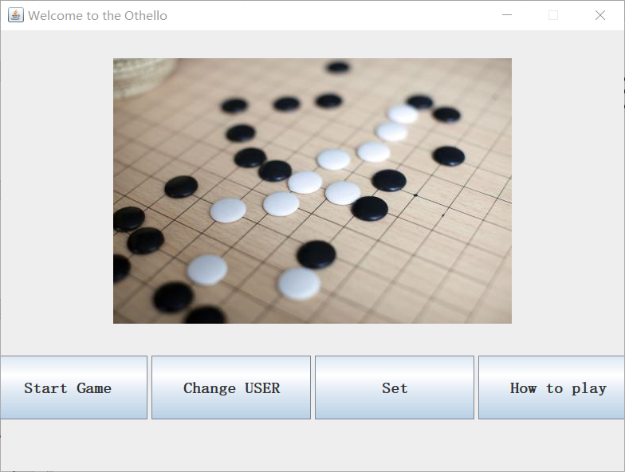
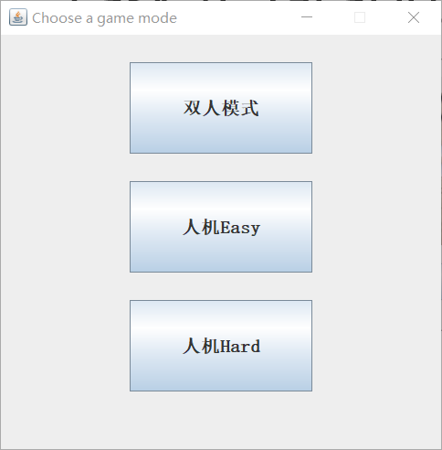
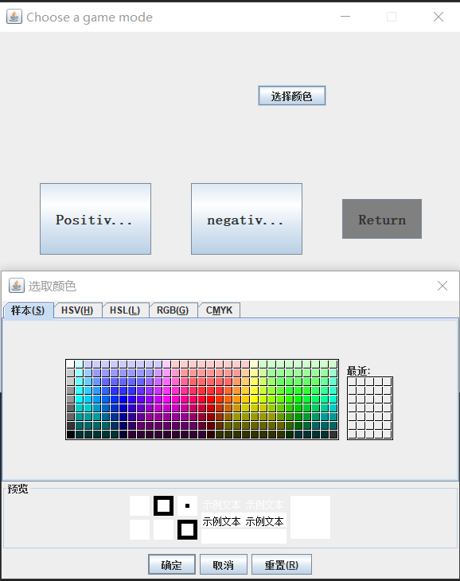
Task 4: Graphical User Interface (20 pts)

Slide 6
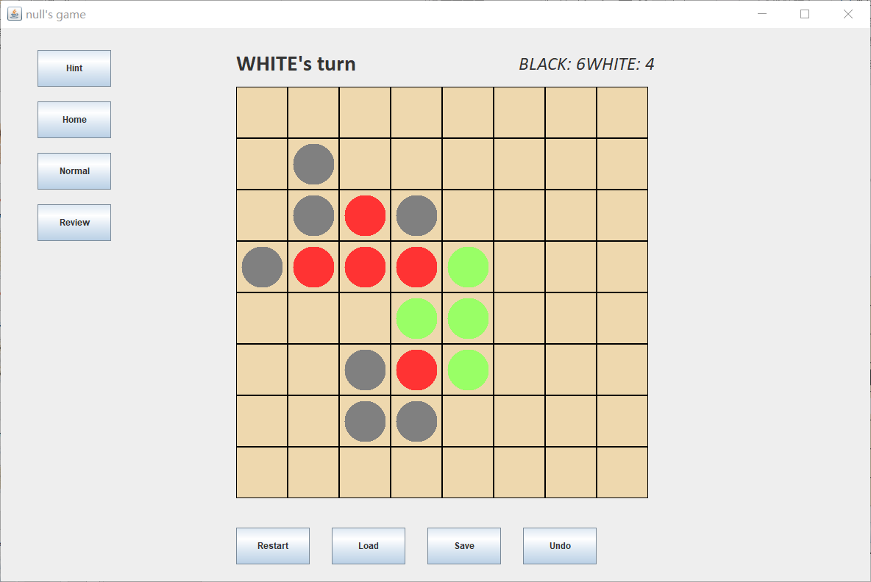
Bonus (20/30 pts):
Human vs Robot
Easy & Hard
Platform
Starting Menu & Modes & Settings & Multi-User
Looks Nicer
Change Color & Have Background Music & Sound Effect
Possible Moves
Hint
Undo Operation
Undo
Replay Process
Review
Execute Without JRE
Execute Without JRE

